Slide 1
Medical Equipment Procurement

Slide 2
Our Group
Prashil Jambhulkar [ Roll No.: 39 ]
Sampatlal Jangid [ Roll No.: 40 ]
Siddharth Kale [ Roll No.: 51 ]
Vedant Mahajan [ Roll No.: 75 ]

Slide 3
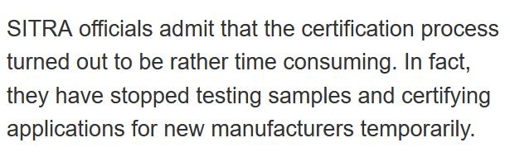
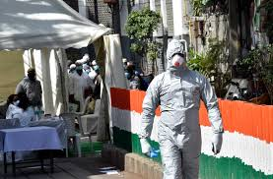

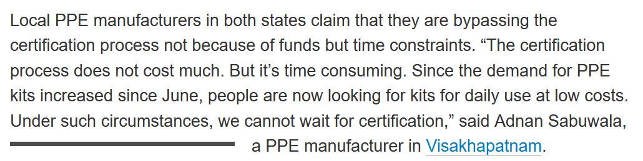
PPE certification is time consuming (SITRA statement)

Slide 4
Problem Statement
Substandard Quality Medical Equipment ( Masks and PPE kits) are manufactured and sold in the market at very cheap prices that are not safe.
When these equipment reach hospitals they have to be Of Good Quality and Certified as they may hurt Patients As Well As Doctors and Hospital reputations. But it is difficult for hospitals to track i.e
Where they were manufactured? ( traceability )
How did it get there? ( traceability )
Is it Good Quality Medical Equipment? ( Build Trust )

Slide 5
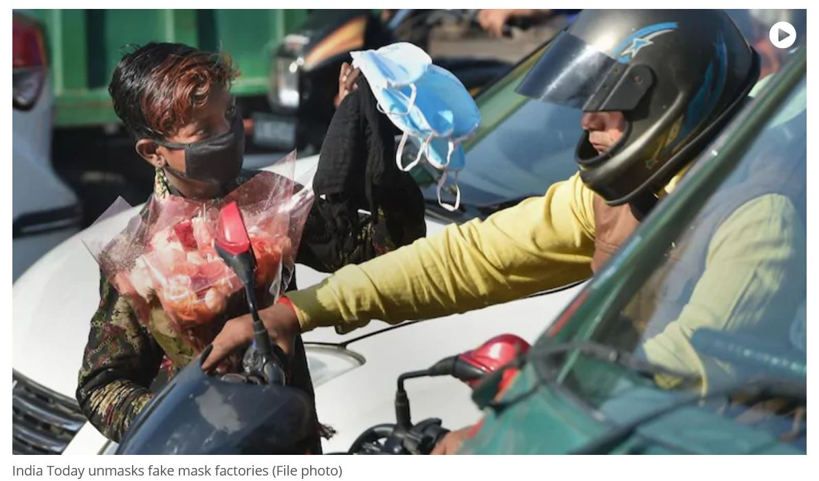
Unsafe and Uncertified PPE kits and masks sold in market at very cheap prices

Slide 6
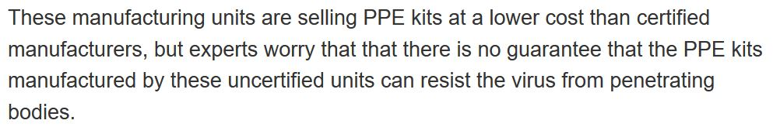
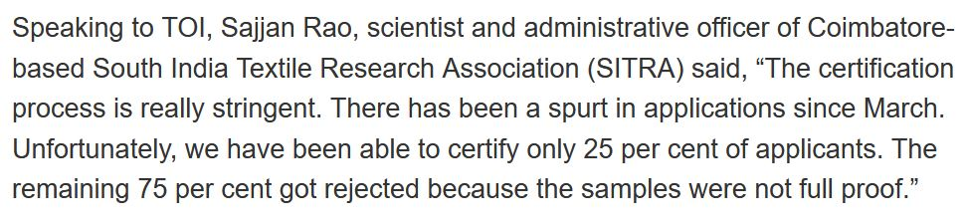

Slide 7
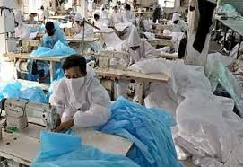

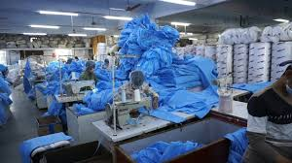
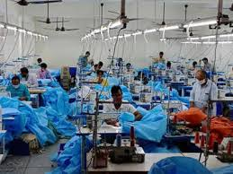
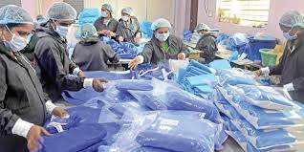
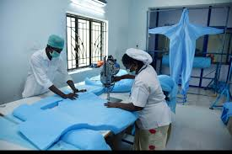
PPE manufacturers cropping up that make Substandard Quality Masks and PPE kits

Slide 8




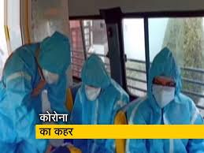
Doctors at Risk. Patients at risk. Citizens at risk.

Slide 9
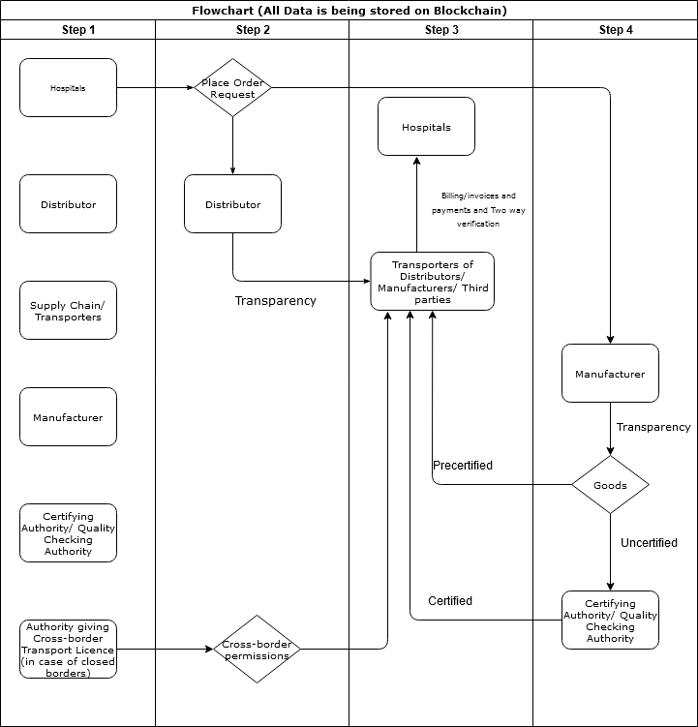
PLAN

Slide 10
Solution - Blockchain Technology
How Blockchain is going to solve this problem?
So we will be having a Distributed Ledger for storing the data of transactions ( who transfers assets to whom ). As well as details of assets and agents.
One of the fields in that detail is Location ( lat , long) of an asset that is to be updated when that asset is transferred from one place to another.
We have used the Leaflet Library that allows us to display maps on our Django Application.

Slide 11
What is Blockchain ?
A blockchain is an append-only database of transactions that is distributed to all participants in a blockchain network. There is no owner, administrator, or centralized data storage. Participants do not necessarily belong to the same enterprise or organization.
Another term for blockchain is distributed ledger , because the database can be thought of an electronic ledger of transactions (state changes) to the data. This distributed ledger is:

Slide 12
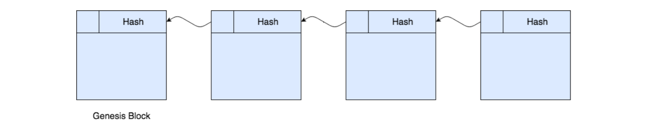
Each block on the blockchain contains transaction data and a header with a timestamp, signer, and hash value.
The hash value is a cryptographic signature or digital fingerprint that uniquely identifies the data in that block, as well as the block’s position in the blockchain.
Each block’s hash includes the hash value of the previous block, which makes it very difficult for a malicious actor to change a previous block. Importantly, the hash algorithm takes an input string of any length and produces fixed-length output. Common blockchain hash algorithms include RIPEMD and SHA-2, (such as SHA256 and SHA512). A blockchain starts with a genesis block.

Slide 13
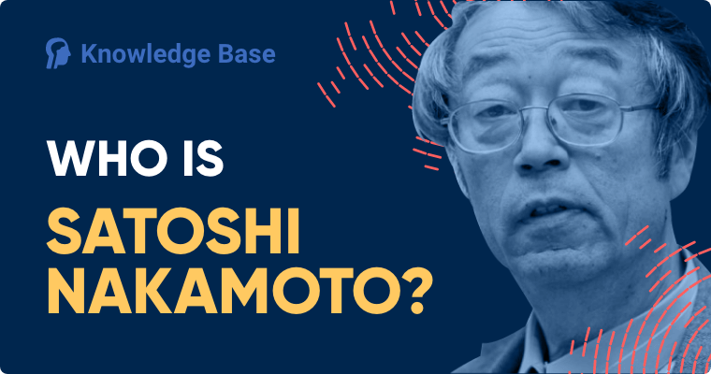
Who is founder ?
Satoshi Nakamoto is the name used by the presumed pseudonymous person or persons who developed bitcoin, authored the bitcoin white paper, and created and deployed bitcoin's original reference implementation.
As part of the implementation, Nakamoto also devised the first blockchain database.

Slide 14
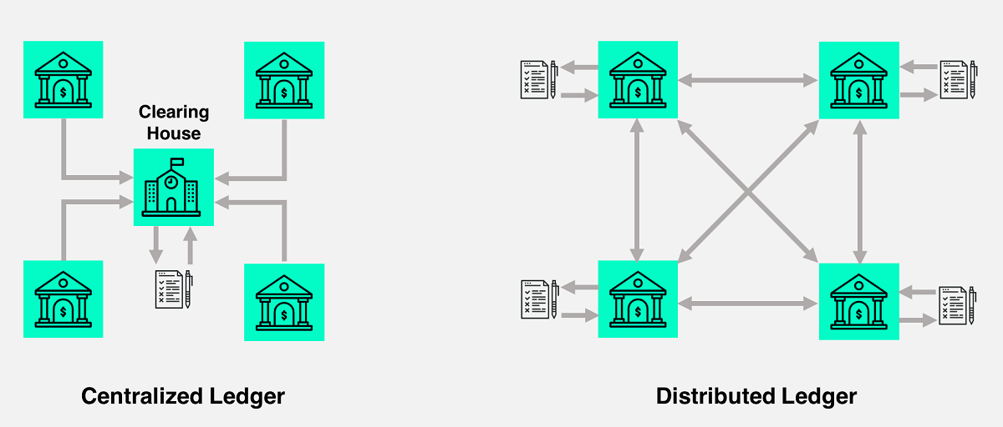
Distributed Ledger
Blockchain Concept -
By Satoshi nakamoto
Banks, Government,
Court etc.
Only Bank Has Database

Slide 15
Why ?
Let’s look at some of the biggest advantages of using blockchain technology:
You get a history of activity, not just a snapshot in time. When you look at a regular database, you’re getting a snapshot of data that’s up to date in that moment in time. Blockchains do this too, but they also maintain a record of all the information that existed before. It’s a database with history, if you like.
There’s no one, central point of attack. The fact that blockchain is a decentralised way of storing and accessing data makes the whole system incredibly secure – because, unlike a centralised database, there’s no one single point of entry for hackers. This makes it particularly useful for recording transactions in a secure manner.
And no centralised control. Because the system of record is decentralised and replicated in its entirety in multiple places, there’s no need for a central administrator and all the costs and infrastructure that comes with it.

Slide 16
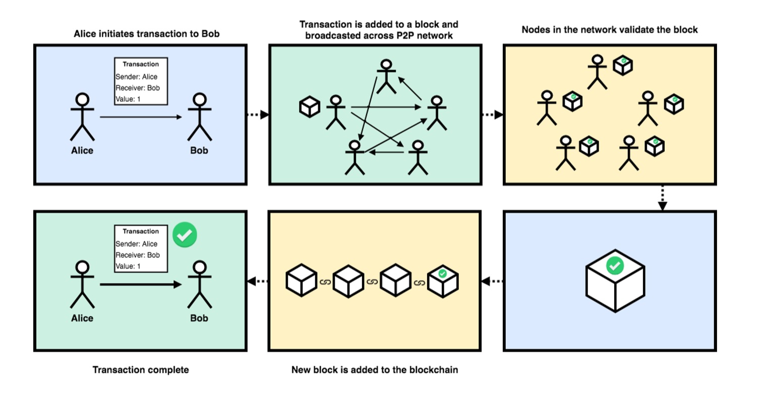
How Does Blockchain Work ?

Slide 17
Where to use?
Applications of Blockchain
Blockchain technology is designed for applications that need a decentralized, distributed database with no central control or owner. Participants can be “mutually distrusting,” such as competitors in the same business space.
Cryptocurrency
Bank Settlement
Supply Management

